Slide 1

Time Series Analysis and Modeling Final Term Project
Team member:
Hsueh-Yi Lu

Slide 2
Outline
Project Introduction
Dataset Introduction
Preprocessing
Stationary
Time Series Decomposition
Holt’s Winter Test
Feature Selection
Base-model
Multiple Linear Regression
ARMA, ARIMA ,and SARIMA Model
Levenberg Marquardt Algorithm
Diagnostic Analysis
Deep Learning Model
Final Model Selection
Forecast Function
h-step Ahead Predictions
Summary and Conclusion

Slide 3



Project Introduction
Notes:
Th goal of this project is to predict the electricity load by using time series skills

Slide 4

Dataset

Slide 5
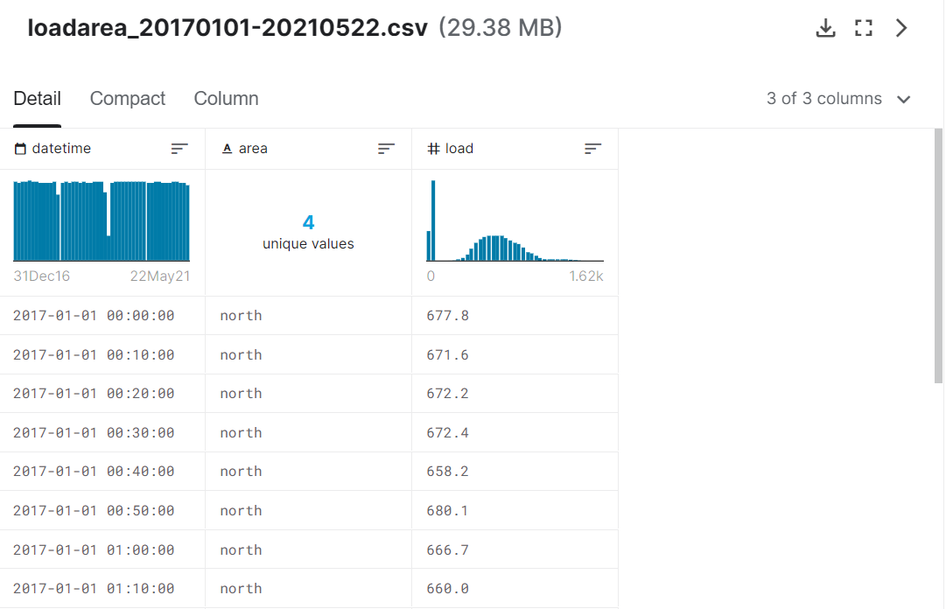
Dataset load
Notes:
Recods the load data from 2017 to 2021

Slide 6
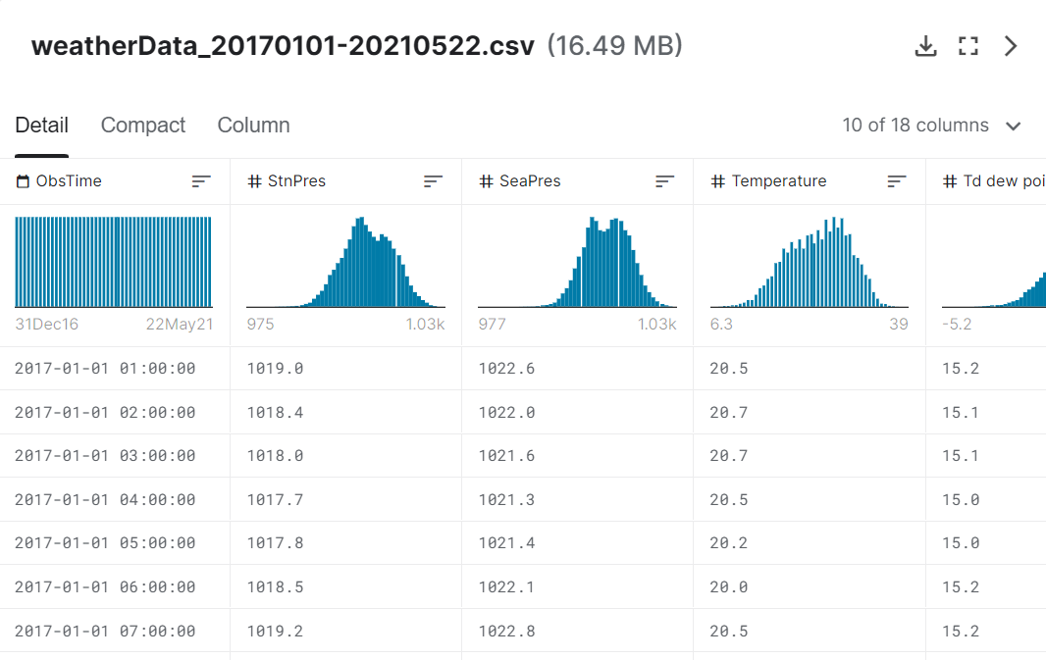
Dataset weather
Notes:
StnPre – stationPressure 測站氣壓(hpa)
SeaPres- 海平面氣壓(hpa)
Temperature - 溫度 (c)
Td- dew point 露點 (c)
RH- relativeHumidity 相對溼度 (%)
WS- windspeed 風速 (m/s)
WD- winddirection風向 (360degree)
WSGust- 最大陣風 (m/s)
WDGust- 最大陣風風向 (360degree)
Precp- precipitation降水量 (mm)
PrecpHour-降水時數 (hour)
Sunshine- 日照時數 (hour)
GloblRad- 全天空日射量 (MJ/m^2)
Visb- 可見度？？
UVI- 紫外線指數
CloudAmount- 總雲量(0~10)

Slide 7
Data Preprocessing
Merging dataset
Missing value
Dependent variable versus time
ACF/PACF of the dependent variable
Correlation matrix

Slide 8
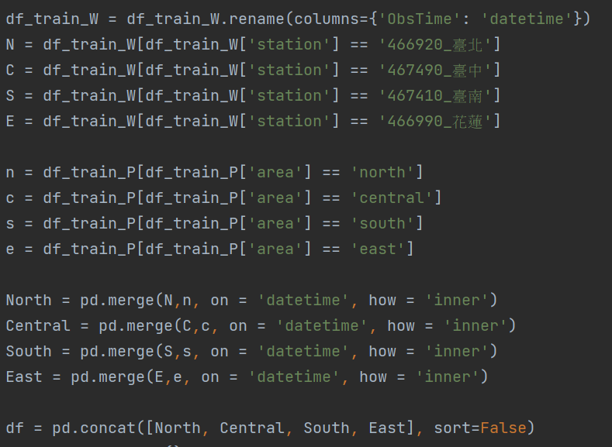
Merging datasets

Slide 9
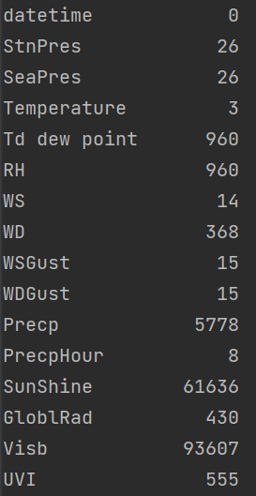
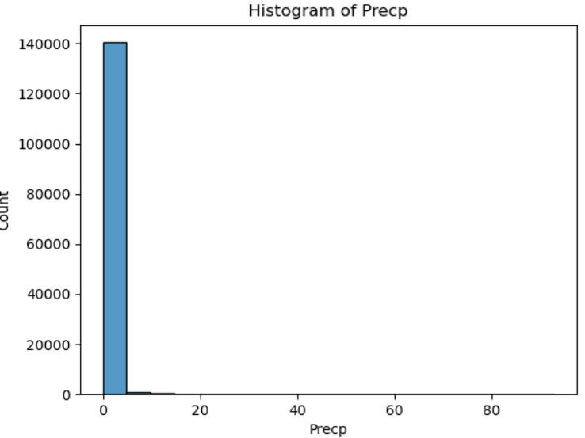
Missing value
Notes:
Fill the missing value , look inside the data and fill with proper values

Slide 10
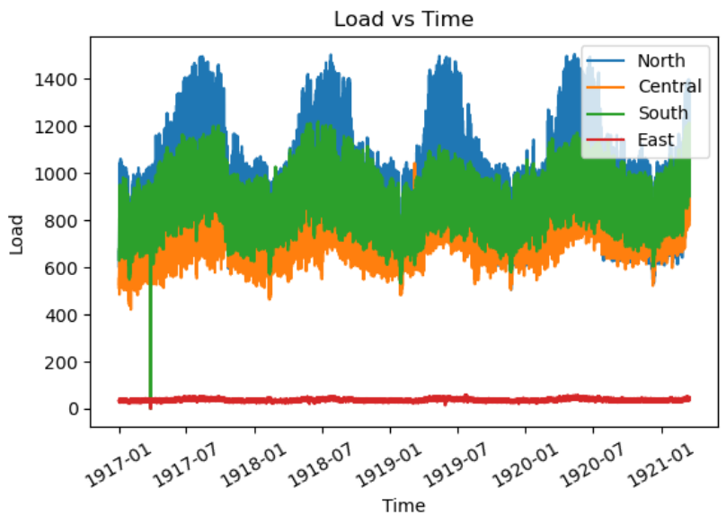
Dependent variable versus time

Slide 11
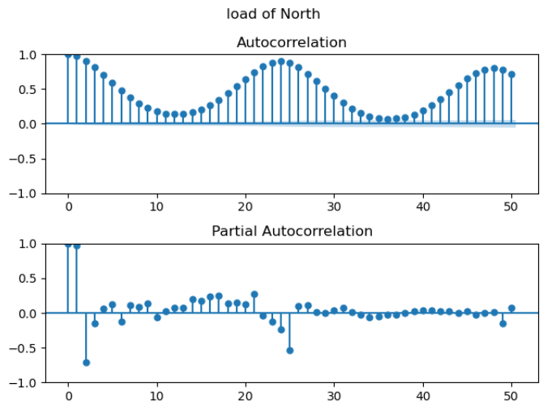
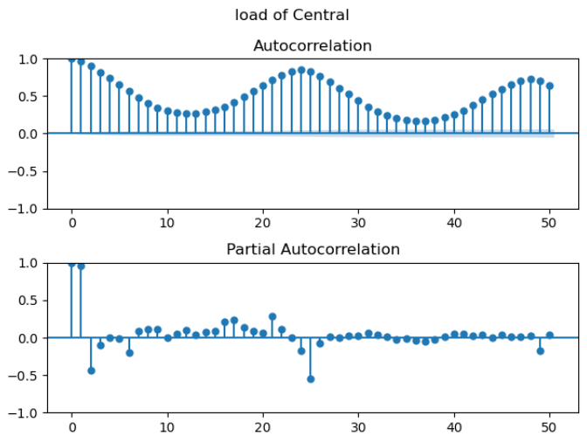
ACF/PACF of the dependent variable

Slide 12
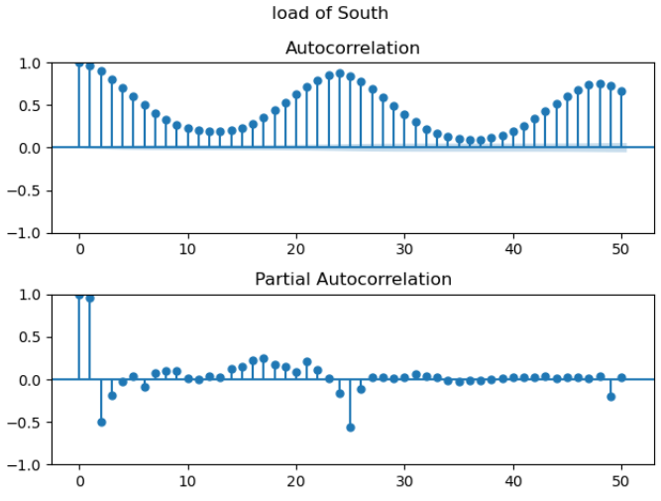
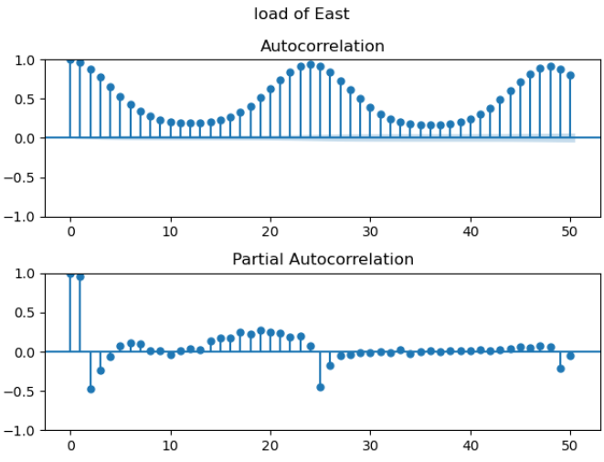
ACF/PACF of the dependent variable

Slide 13
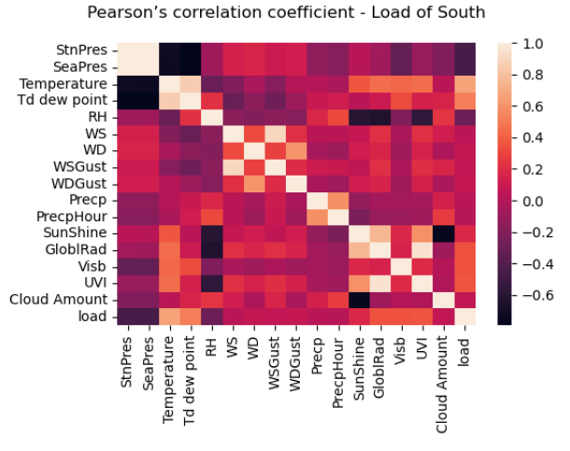
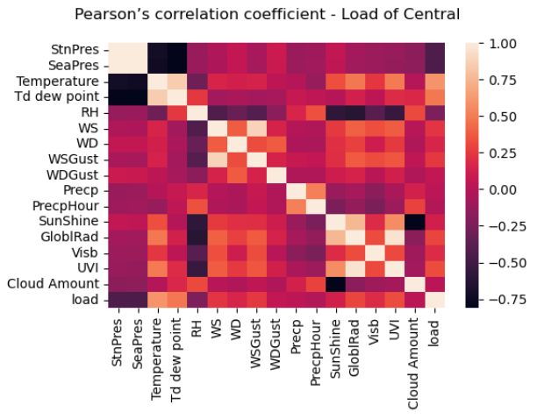
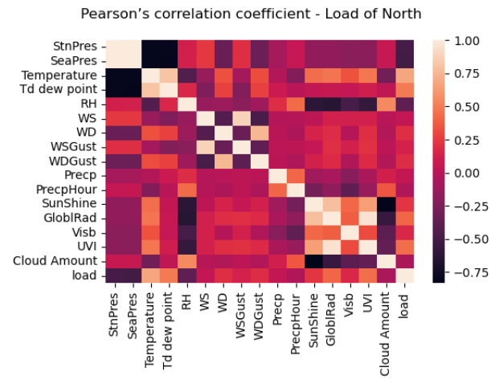
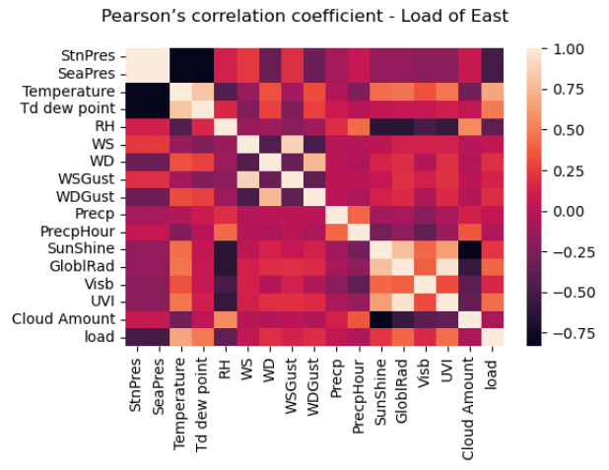
Correlation matrix
Notes:
No big difference so I used North data for the rest of the project

Slide 14
Stationary
ADF-test
KPSS-test
Rolling mean & rolling variance

Slide 15
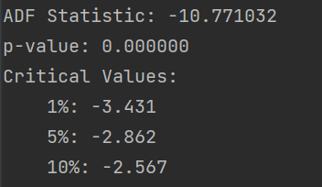
ADF-test
Notes:
P-value close to zero

Slide 16
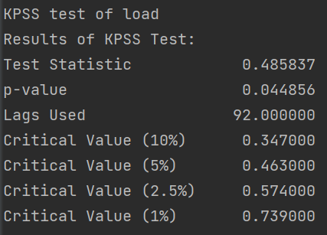
KPSS-test
Notes:
P-value close to 0.05

Slide 17
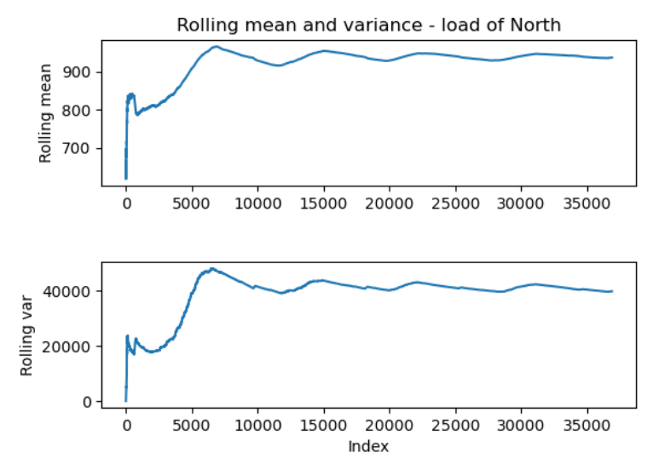
Rolling mean & variance

Slide 18
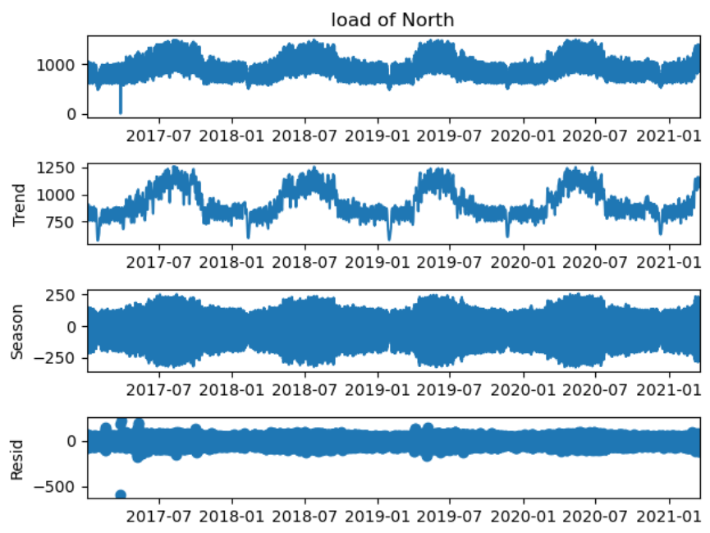
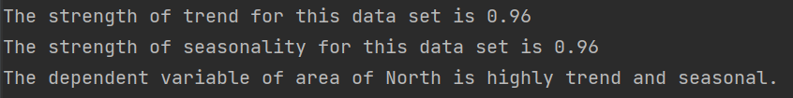
Time series Decomposition

Slide 19
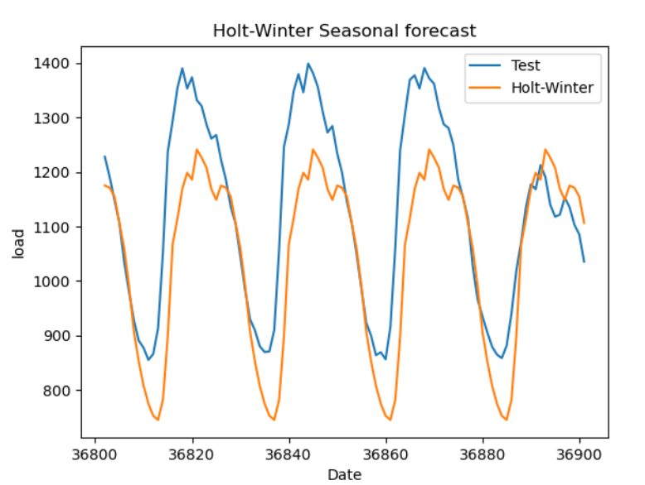
Holt-Winters Method

Slide 20
Feature Selection
SVD
Condition number
Backward stepwise regression
Random Forest Feature Importance

Slide 21
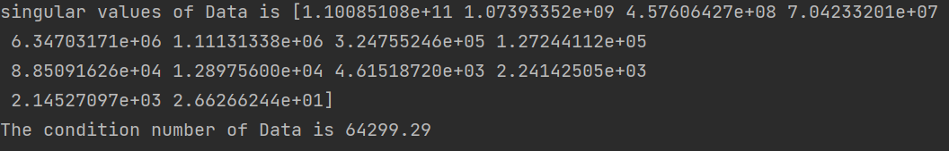
singular values of data Condition number
Notes:
Condition number too high SVD number not close to zero

Slide 22
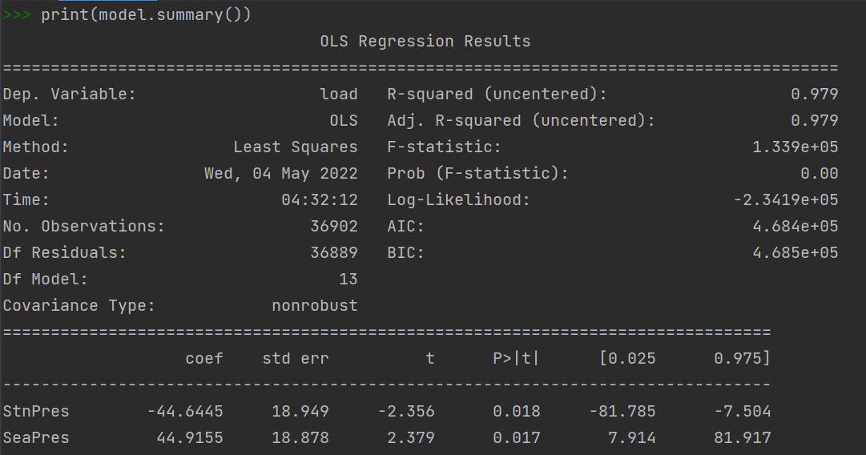
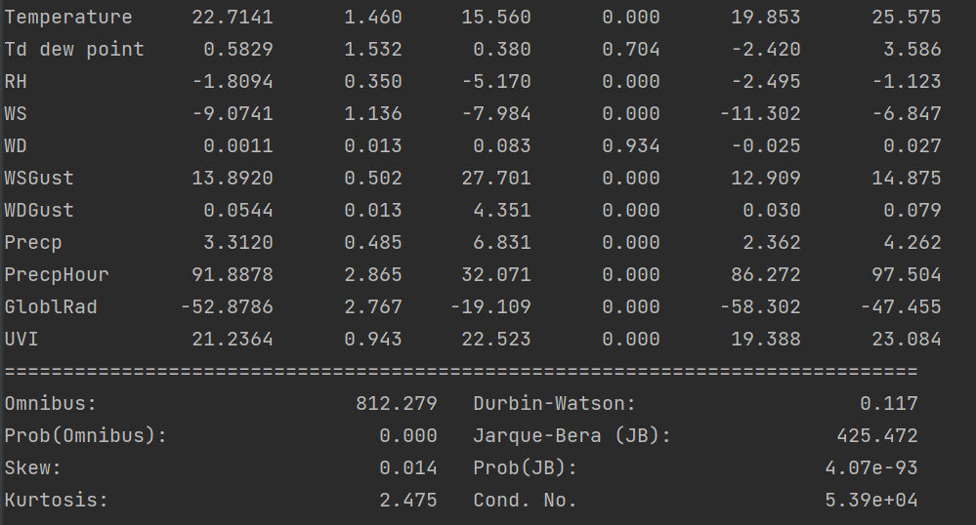
OLS model feature backward stepwise

Slide 23



Slide 24
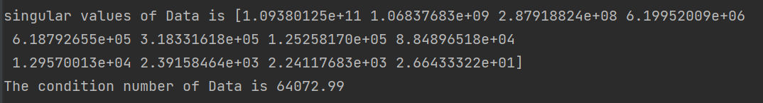
Final SVD & condition number
Notes:
Condition number drop

Slide 25
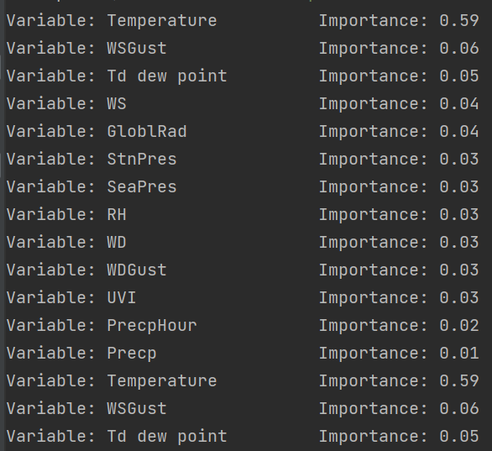
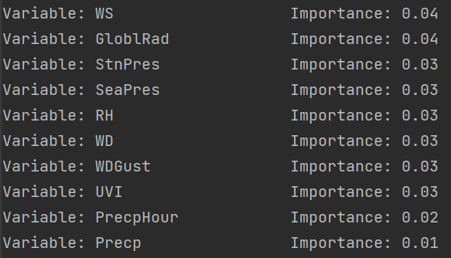
Random forest feature importance
Notes:
Condition number still high

Slide 26
Base-model
AFM
Naïve
Drift
SES

Slide 27
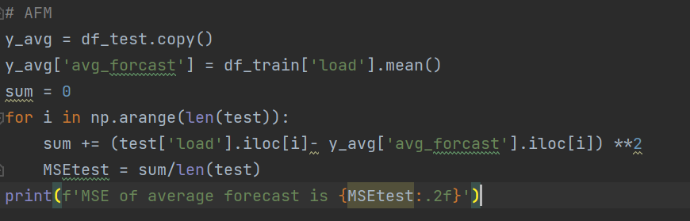
Average forecast method

Slide 28
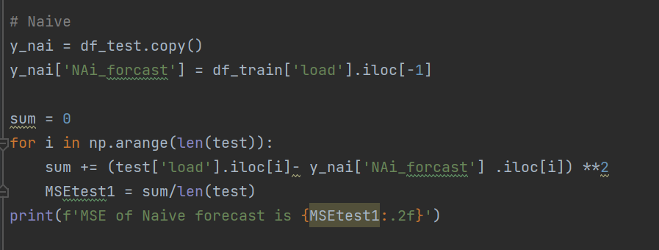
Naïve method

Slide 29
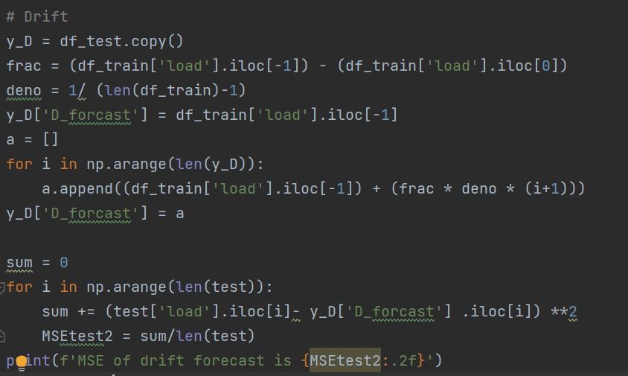
Drift method

Slide 30
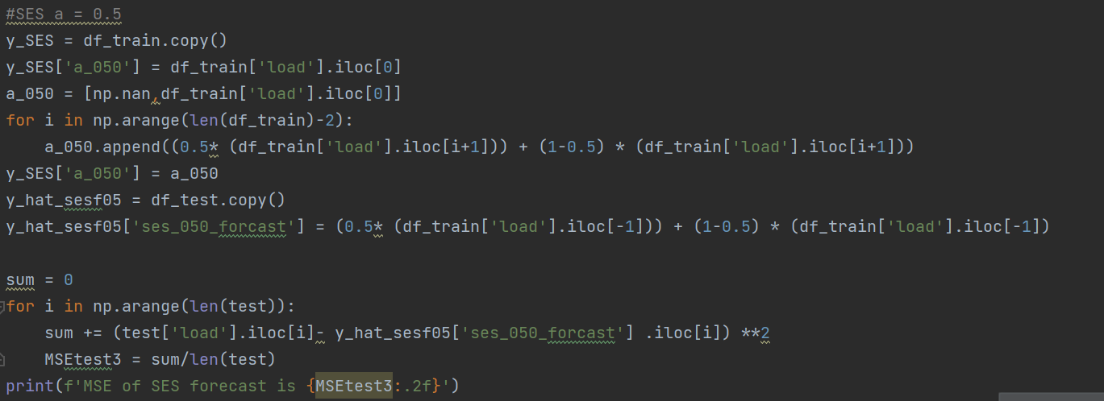
Single Exponential Smoothing method
Notes:
Alfa = 0.5

Slide 31
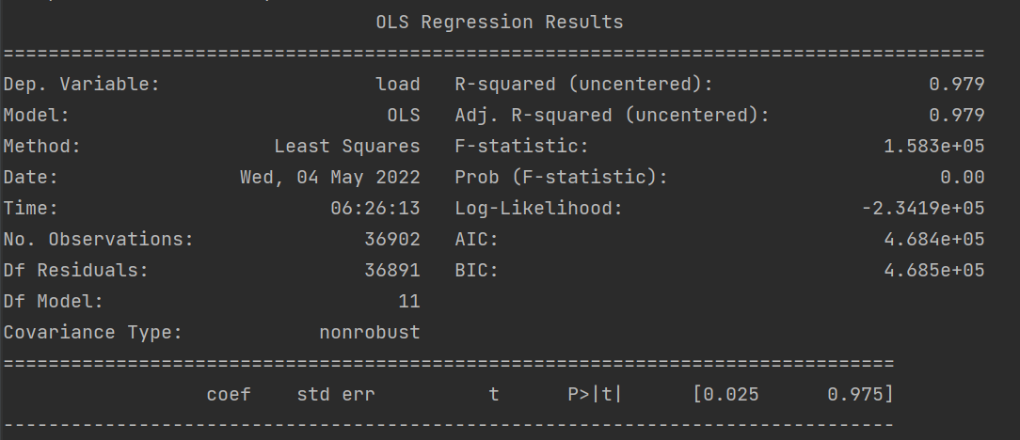
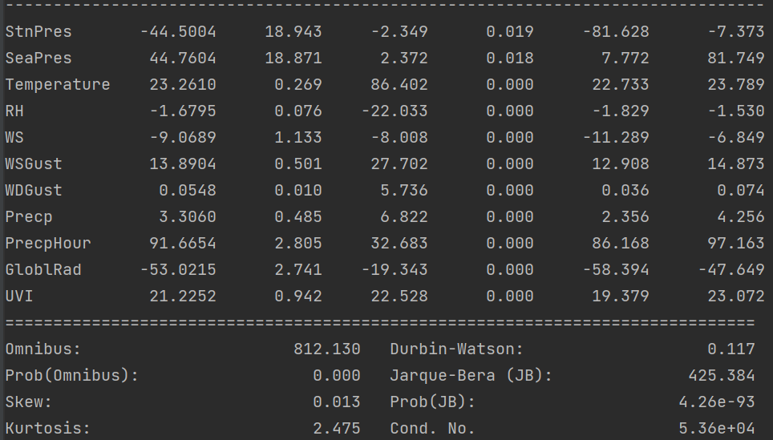
Multiple Linear Regression

Slide 32
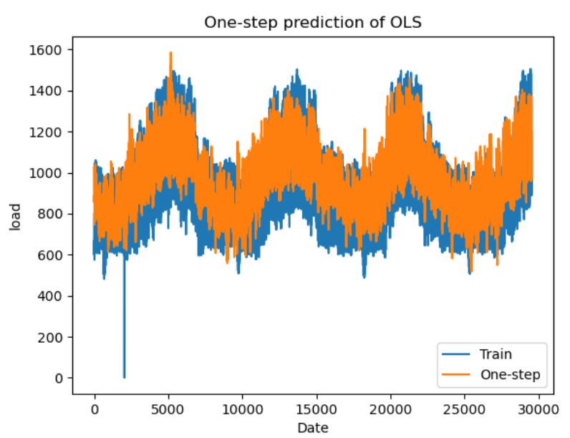
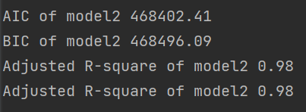
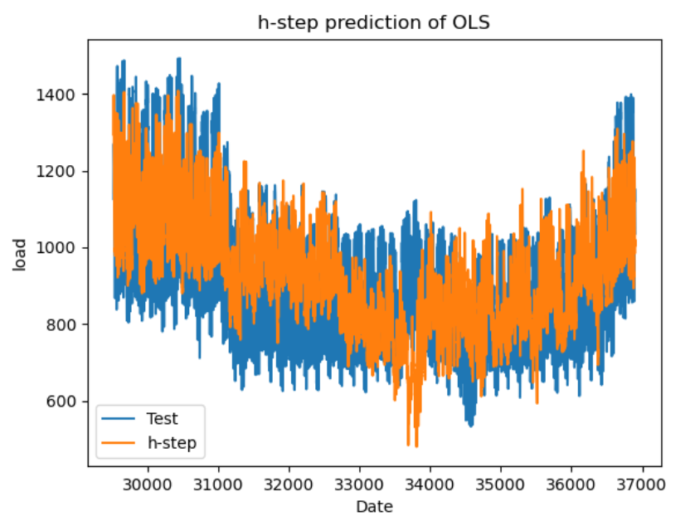
Multiple Linear Regression

Slide 33
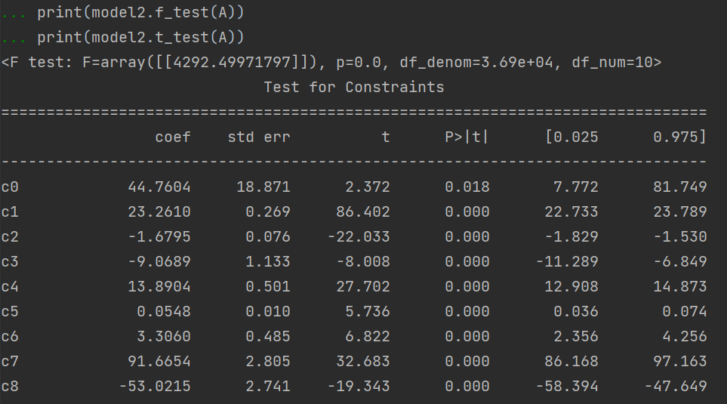
Multiple Linear Regression
Mean of residual and variance of residual
Q-value
ACF of residual
F-test & T-test

Slide 34
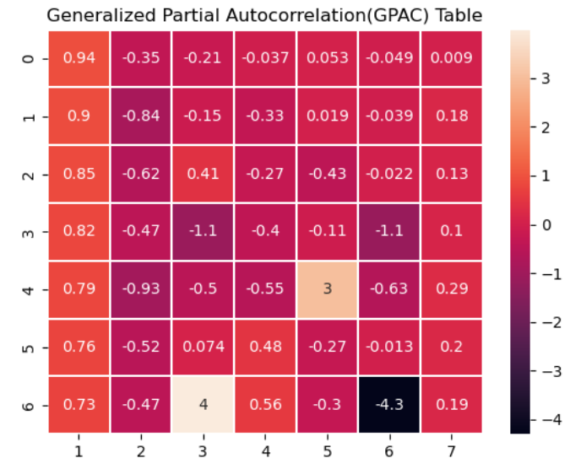
ARMA, ARIMA, and SARIMA Model

Slide 35
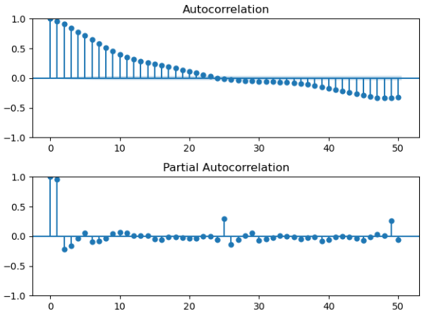
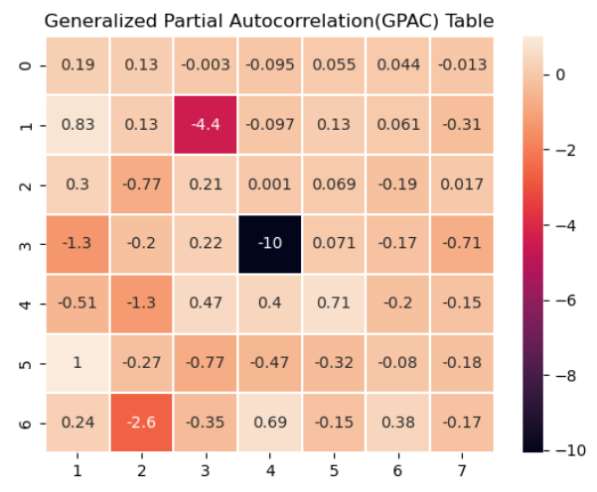
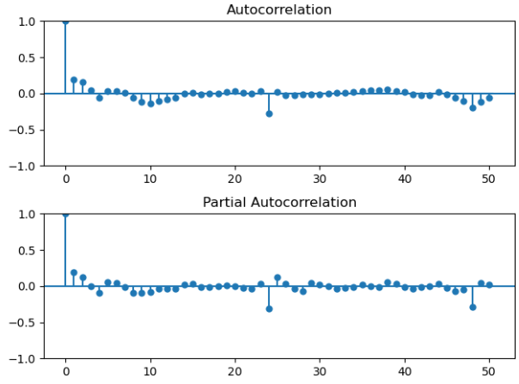
SARIMA(0,1,0)24 or SARIMA(1,0,0)24
Notes:
SARIMA(0,1,0)24 or SARIMA(1,0,0)24

Slide 36
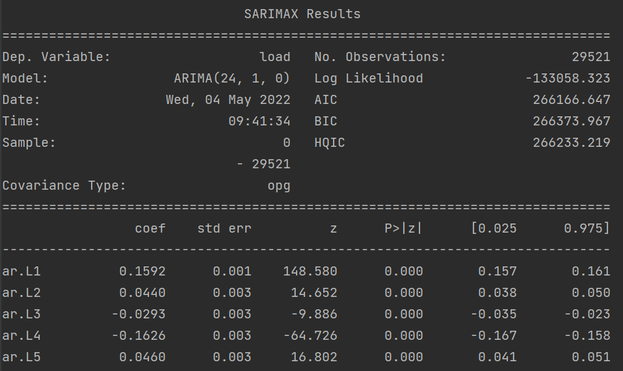
Levenberg Marquardt Algorithm
SARIMA(1,0,0)24
Or
ARIMA(24,1,0)

Slide 37
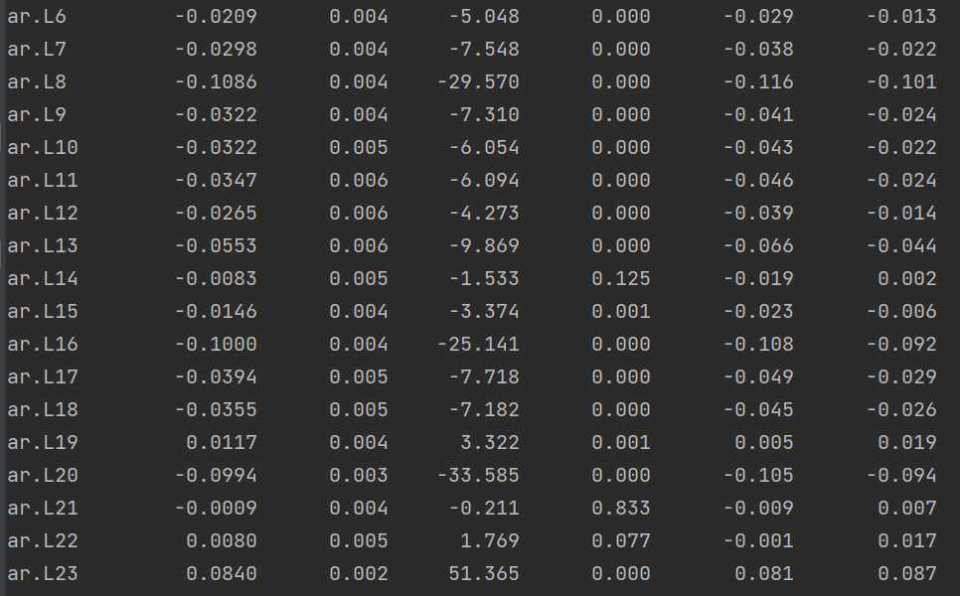
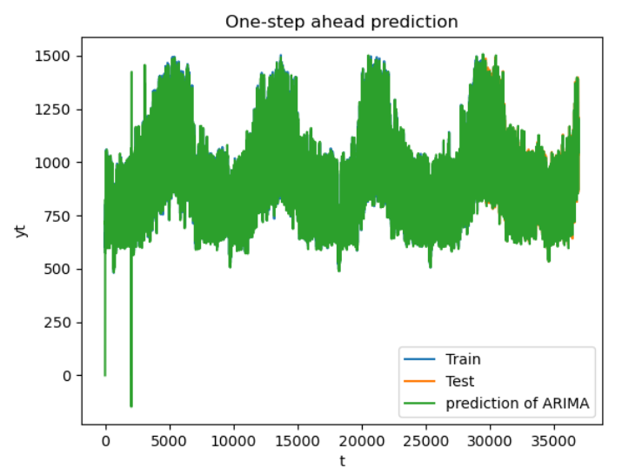
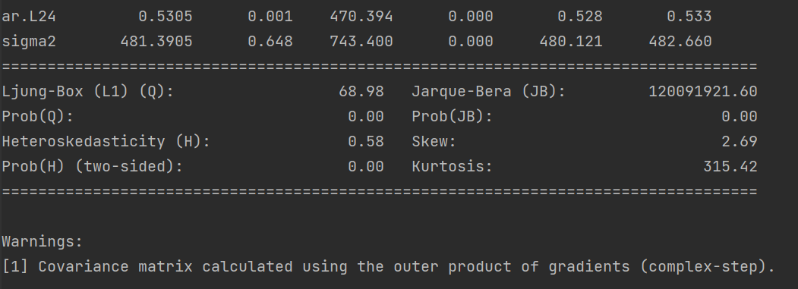
Summary

Slide 38
Diagnostic Analysis
Confidence Interval
Zero/Pole Cancellation
Chi-square test
Estimated Variance & Covariance Matrix
Variance of residual & forecast error

Slide 39
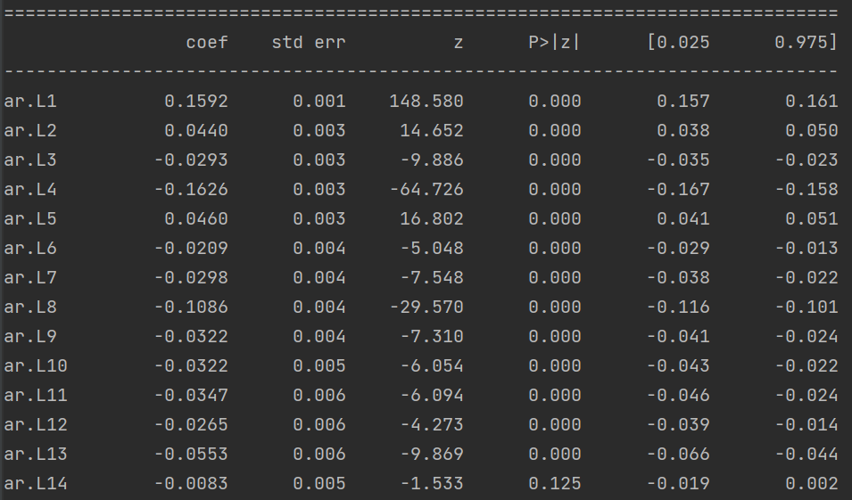
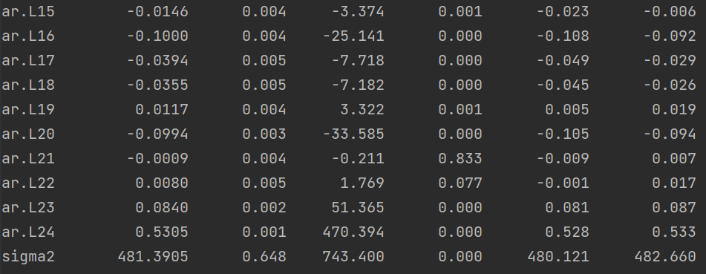


Confidence Interval Zero/Pole Cancellation

Slide 40
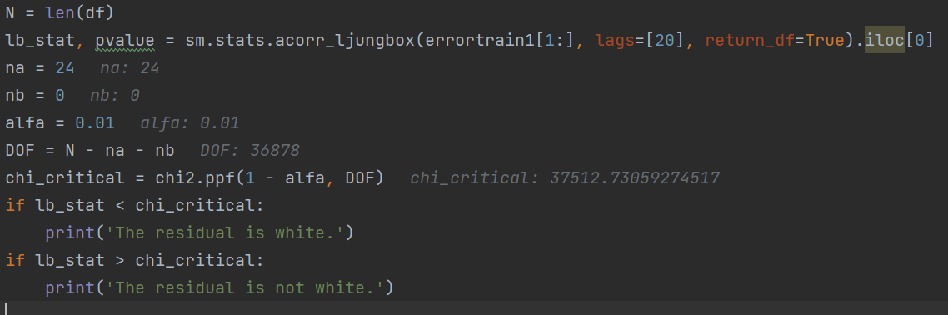
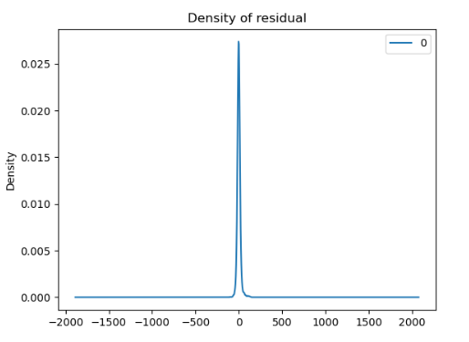
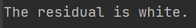
Chi-square test

Slide 41
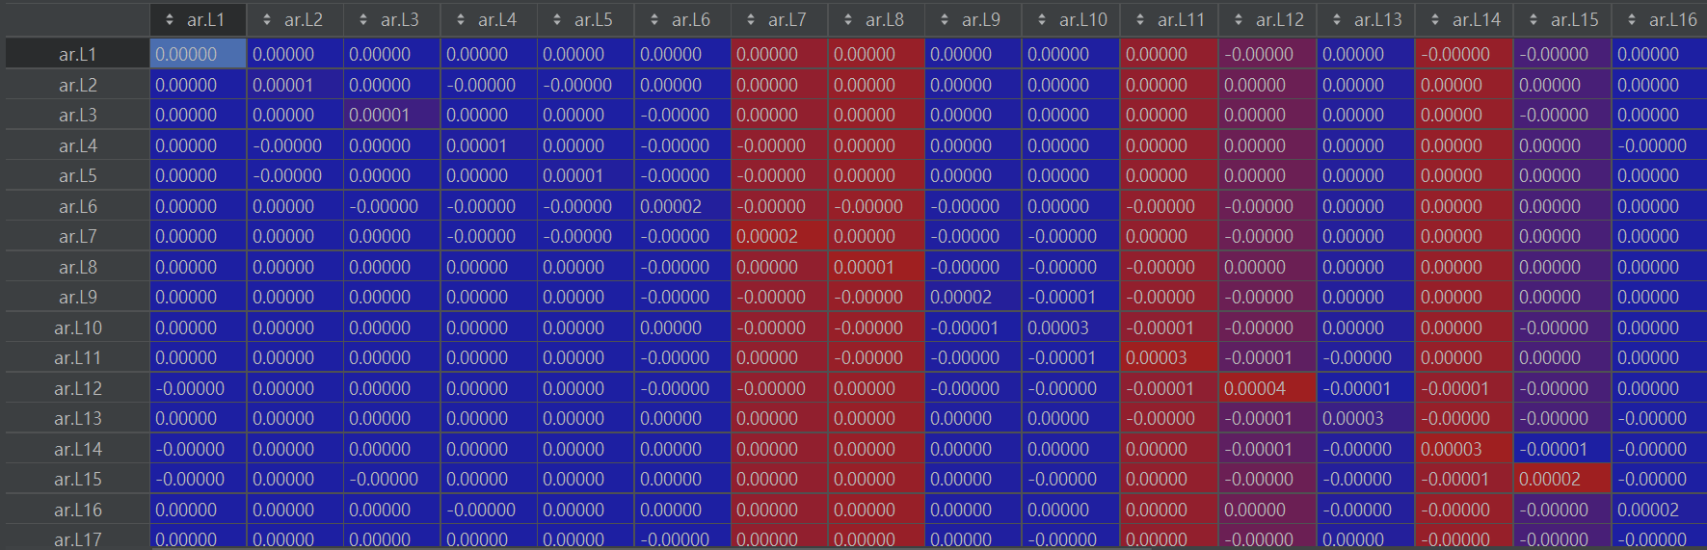



Estimated variance & covariance matrix

Slide 42



Variance of forecast error & residual

Slide 43


Deep Learning Model

Slide 44

Final Model Selection

Slide 45

Forecast function
𝑦(𝑡)
– 0.16*𝑦(𝑡 − 1)
– 0.5*𝑦(𝑡 − 24)
= 𝑒(𝑡)

Slide 46
Conclusion
Deep learning model
versus
traditional model
Time series variables

